Slide 1
Hand-written Digits Recognition
ML Programming
AI-JUNCTION

Slide 2
Image classification using Deep Neural Network
Problem Statement
Classify images of handwritten digits
Multiclass Classification problem – 10 classes for the digits
Using Deep Neural Network
Logic
Understand the DNN architecture used in this program
Use of Keras for building the DNN
Loading the data, creating the train and test data sets
Dataset
MNIST Dataset (https://en.wikipedia.org/wiki/MNIST_database)
60000 training images + 10000 test images
Another 28000 images for prediction
Visualize
Look at individual images – use matplotlib
Plot the actual images vs predicted classes
Visualize the weights between input layer and the hidden layer in the DNN

Slide 3
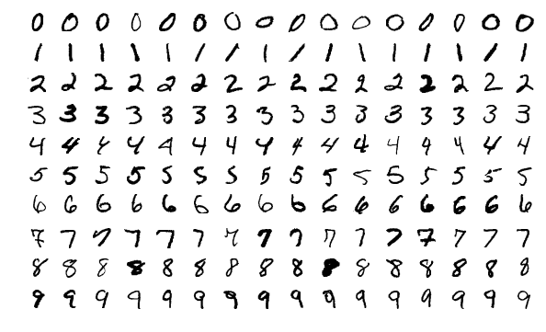
MNIST Dataset

Slide 4
Useful Links
Source code: https://github.com/AI-Junction/Image-Recognition/blob/master/Digits-Recognition/mnist-cnn-V3.py
MIST database: https://en.wikipedia.org/wiki/MNIST_database
Test.csv: https://drive.google.com/file/d/1hXp9AR3TgbxdynvL11nsi1vV6BMa0Nv6/view?usp=sharing

Slide 5
A Word About SGD (Stochastic Gradient Descent)
Stochastic Gradient Descent takes a random instance in the training set at every step and
computes the gradients only on that single instance.
This makes the algorithm much faster due to little data to manipulate at every iteration.
It also makes it possible to train on huge training sets, since only one instance needs to be in memory at each iteration
This algorithm is much less regular than Batch due to its stochastic (i.e., random) nature,
Over time SGD adjusts the weights close to the minimum, but once it gets there it will continue to bounce around, never settling down

